Slide 1
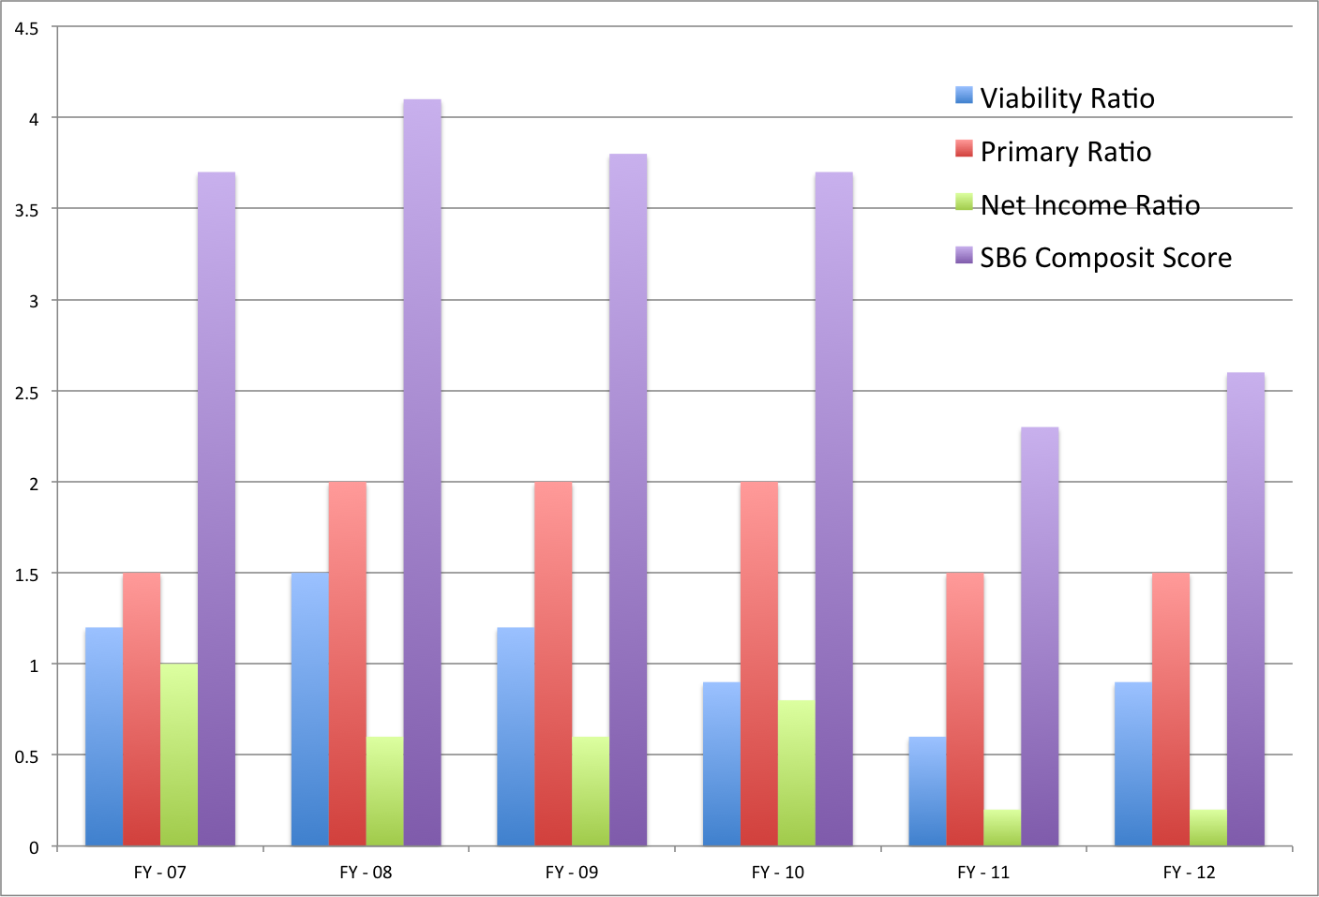
THEME 1: Fiscal Health – SB-6 Ratios
Maximum score is 5.0; Fiscal Watch begins at 1.7

Slide 2
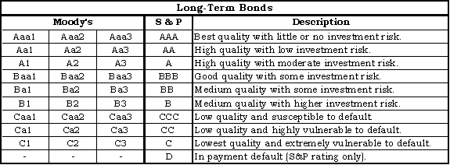
THEME 1: Fiscal Health – S&P; Moody’s
YSU – Moody’s – A2
YSU – S&P – A+

Slide 3
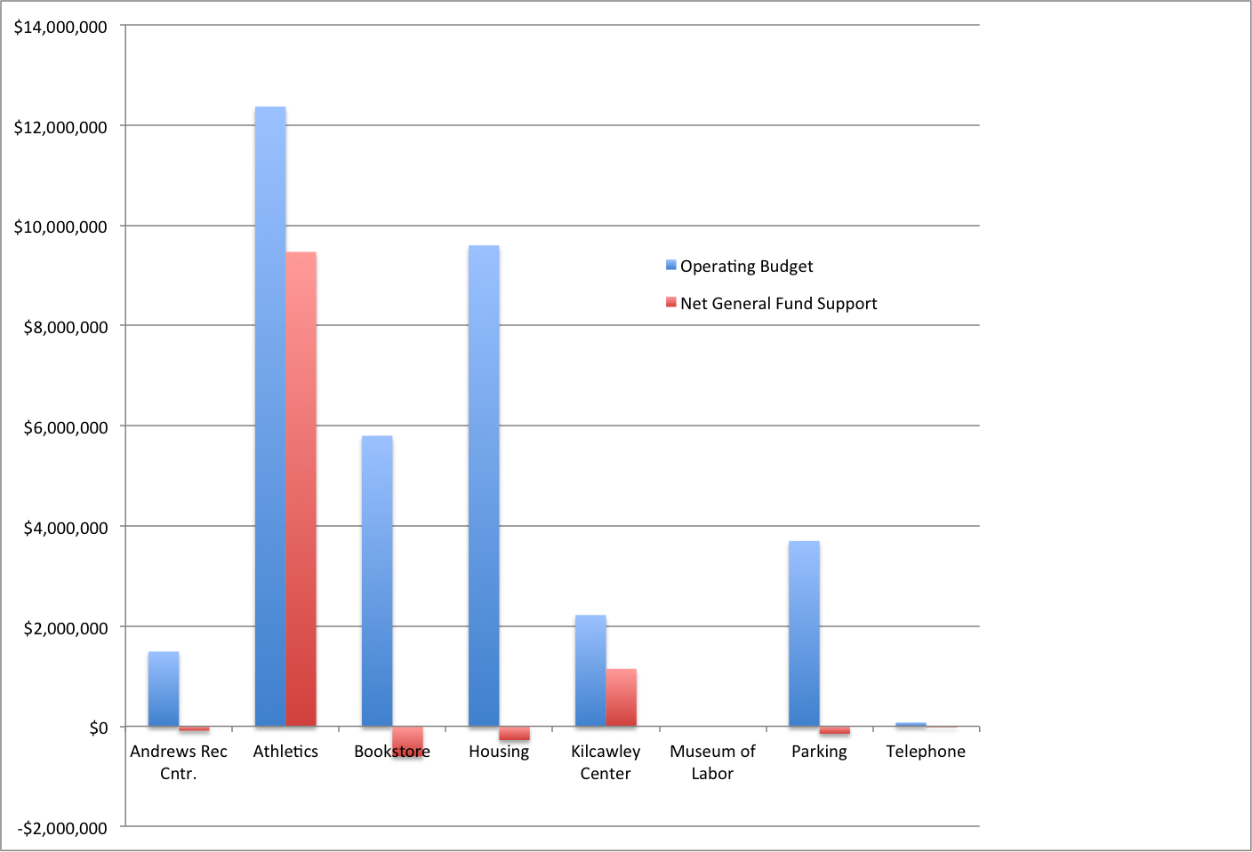
THEME 1: Fiscal Health – Auxiliaries
Net general fund support below $0 is a characteristic of fully self-funded
auxiliary units that pay an overhead fee to the University.

Slide 4
THEME 1: Fiscal Health – Development Goals

Slide 5
THEME 2: HR Health – Employee Training
Technology Training By Fiscal Year
Year | Sessions | Participants | Benefits Eligible Employees | % Employee Participation
2009-2010 | n/a | n/a | n/a | n/a
2010-2011 | n/a | n/a | n/a | n/a
2011-2012 | 122 | 670 | 1201 | 56%
2011-2012* | 152 | 1022 | 1201 | 85%
Wellness Training By Fiscal Year
Year | Sessions | Participants | Benefits Eligible Employees | % Employee Participation
2009-2010 | 14 | 301 | 1255 | 24%
2010-2011 | 20 | 296 | 1269 | 23%
2011-2012 | 19 | 288 | 1201 | 24%
*Based on the total number of participants / benefits eligible employees.
Percentage reflects a total head count per session rather than unique individual participation.
HR Training By Fiscal Year
Year | Sessions | Participants | Benefits Eligible Employees | % Employee Participation
2009-2010 | 14 | 301 | 1255 | 24%
2010-2011 | 20 | 296 | 1269 | 23%
2011-2012 | 141 | 958 | 1201 | 80%
2011-2012* | 171 | 1310 | 1201 | 109%

Slide 6
THEME 2: HR Health –Diverse Learning Environment Survey
Survey to be coordinated with Employee Satisfaction Survey and to be administered every three years beginning in 2012-2013.

Slide 7
THEME 2: HR Health –Employee Satisfaction
Survey to be coordinated with Employee Satisfaction Survey and to be administered every three years beginning in 2012-2013.

Slide 8
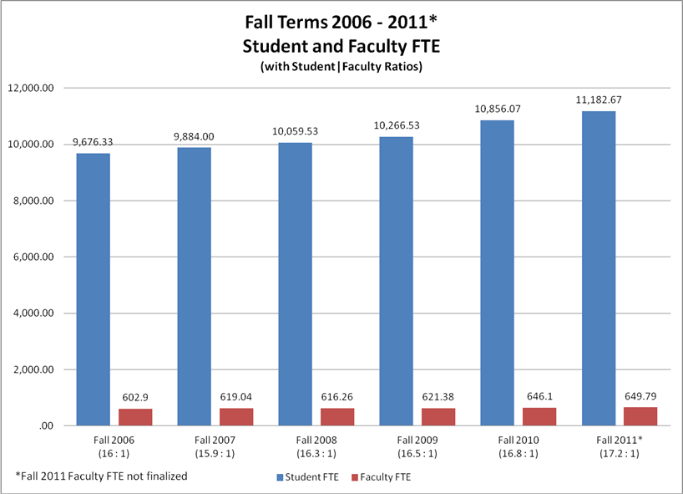
THEME 2: HR Health – Student FTE per Full Time Faculty FTE

Slide 9
THEME 3: Facilities Health – Percentage of Buildings in Satisfactory Condition
Blue is the percentage of buildings in physically satisfactory condition
Red is the percentage of buildings in functionally satisfactory condition
Data are as reported to OBOR. Not included in reporting are buildings which are not currently in use,
or are under construction.

Slide 10
THEME 3: Facilities Health – Percentage Buildings over 25 years old
Currently, 73% of the University’s space is over 25 years old
Average of peer institutions is 64%
Prior to the recent construction of WATTS and Williamson Hall, we had 85% of space over 25 years old

Slide 11
THEME 3: Facilities Health –Utilities cost per gross sq.ft.

Slide 12
THEME 3: Facilities Health – Energy Consumption
Expressed as Kilo-BTUs per Gross Square Feet of space

Slide 13
THEME 3: Facilities Health – Percentage of General Fund used for Maintenance

Slide 14
THEME 3: Facilities Health – Deferred Maintenance
We have established a deferred maintenance backlog of $201.5 million
$79.4 has been identified as needing to be addressed within the next three years
$48.6 within 4 to 7 years
$73.5 within 8 to 10 years

Slide 15
THEME 3: Facilities Health – Environmental Footprint Index
Measured in Metric Tons of CO2 (MT CO2)

Slide 16
THEME 4: Shared Responsibility – Employee Satisfaction
Survey to be administered every three years beginning in 2012-2013.

Slide 17
THEME 4: Shared Responsibility – Savings from Efficiencies
This metric is being re-evaluated to look at the use of an annual ratio of non-instructional costs per FTE student with footnotes to identify reasons for changes in that ratio and/or significant savings. It will appear next year.

Slide 18
THEME 4: Shared Responsibility– Assessment Success

